Slide 1
Expanding Cellular Coverage in Rural Areas
Notes:
Good afternoon everyone! My name is Dawn Harper and I am with UMass Global, and I am excited to talk to you about getting better cellular coverage!

Slide 2
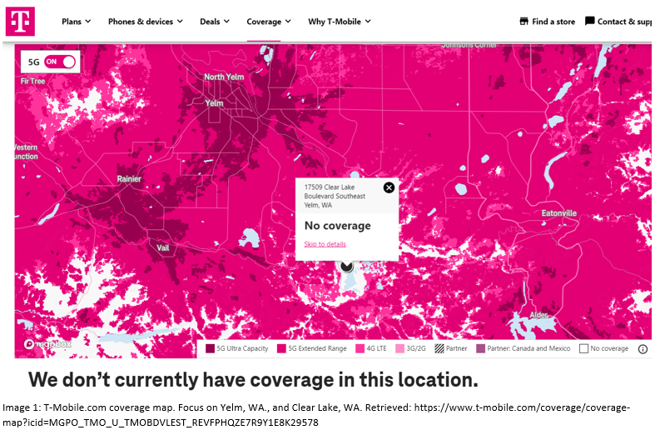
Notes:
The majority of us have seen a cellular coverage map, this one is for T-Mobile who we are teaming up with to meet the lofty goal of providing coverage even in rural areas. What we see here is A LOT of magenta coverage. What we also know is these maps are not always accurate. However, in this case for Clear Lake area it is correct…there is absolutely no coverage in this area.

Slide 3

Image 2: Giphy.com (n.d.). Doing Work From Home. Retrieved: https://giphy.com/gifs/bobble-workfromhome-lockdown-wrk-hTUDzx90zCDBIFBYyW
Notes:
Why is this a good thing? Because no other provider has coverage in this area either. With the recent Covid-19 pandemic many companies have allowed their employees to work from home permanently. What this also means is that more people are leaving large cities to go to rural areas where houses are cheaper.

Slide 4
Return on Investment
Placing towers in rural areas.
Planning ahead to take advantage of lower housing costs.
Work from home migration from big cities to rural areas.
Notes:
Utilizing GIS maps and the cellular industry go hand-in-hand as tower placement is pertinent to the success of the company. The return on investment (ROI) will come as we are now focusing on planning for the future. We are looking to place towers in more rural areas with the anticipation of further migration of those who can work from home, and housing affordability. By providing service where no one does, all the current residents will transfer to T-Mobile and new people moving to area will as well.

Slide 5
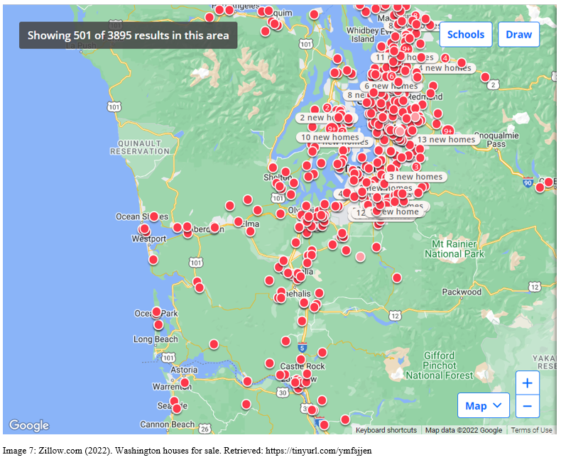
In the Seattle area, a single-family 3 bedroom 3 bath is $808,000, 1630 sq. ft., with a small yard of 3,741 sqft.
Clear Lake area, there is currently a house on the market for $325,000 that is 3 bedroom, 1 bath, 1450 sq ft., on .29 acres.
Image 3: Zillow.com (2022). Washington houses for sale. Retrieved: https://tinyurl.com/ymfsjjen
Notes:
Cost benefit analysis - In the past, it has been cost prohibited to place towers in rural areas, as there were not enough customers to balance need and profit. The goal is to anticipate population growth, which can also be translated as potential customers. “GIS can be applied to every aspect of the cellular industry it pays for itself. GIS can be applied to the land to purchase for a new tower location, current housing markets, estimated population growth, estimated housing markets to find new locations, keep track of current towers, and coverage to ensure maximization on each tower and reduce overlapping of coverage efforts” (Harper, 2022).

Slide 6
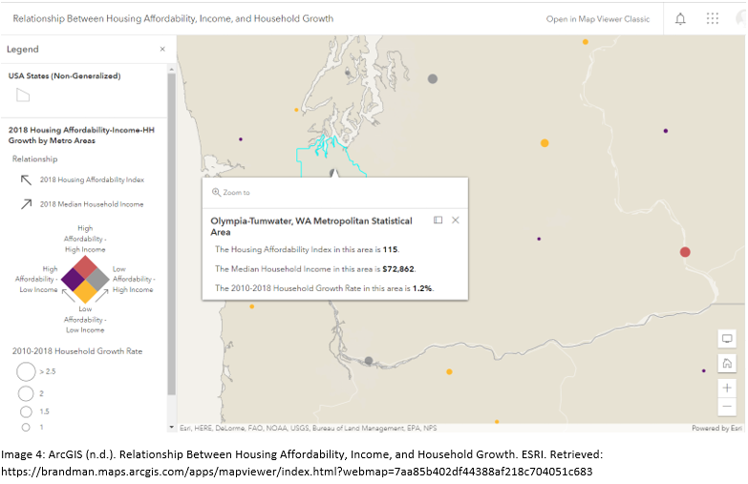
Notes:
GIS alternatives – Housing affordability. Utilizing ArcGIS the map “Relationship Between Housing Affordability, Income, and Household Growth: shows In the current housing market it is more affordable to rural areas than in cities as houses compared to income is more balanced.

Slide 7
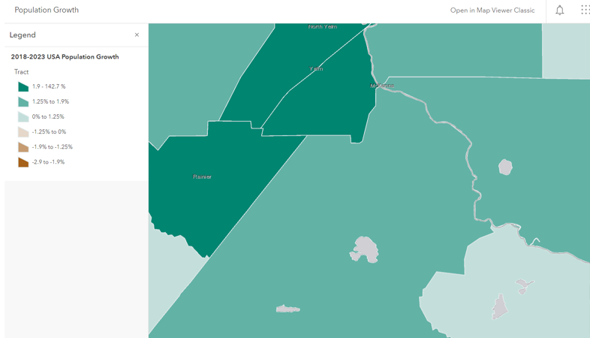
Image 5: ArcGIS (n.d.). Population Growth. Focused on Yelm, WA. ESRI. Retrieved: https://brandman.maps.arcgis.com/apps/mapviewer/index.html?webmap=03ee631561e24 9c98994a906a490949f
Notes:
GIS alternatives – Population Growth. The Population Growth (n.d.) map shows where people are anticipated to be moving to, Yelm, WA. is showing on the higher end of expected growth between 2018-2023.

Slide 8
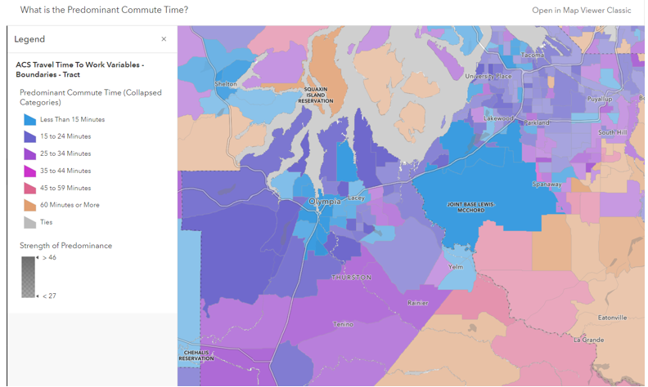
Image 6: ArcGIS (n.d.). What is the Predominant Commute Time? Focus on Yelm, Clear Lake, and JBLM. Retrieved: https://brandman.maps.arcgis.com/apps/mapviewer/index.html?webmap=0dcb73cf46e146a5951b289f259ff332
Notes:
GIS alternatives – With ArcGIS map “What is the Predominant Commute Time?” “previously, a high commute time would be a factor in house prices and would be a deterrent to costs being low. However, with the option to work from home, commute time is less of a deterrent but allows the buyer to take advantage of the lower home prices” (Harper, 2022).

Slide 9
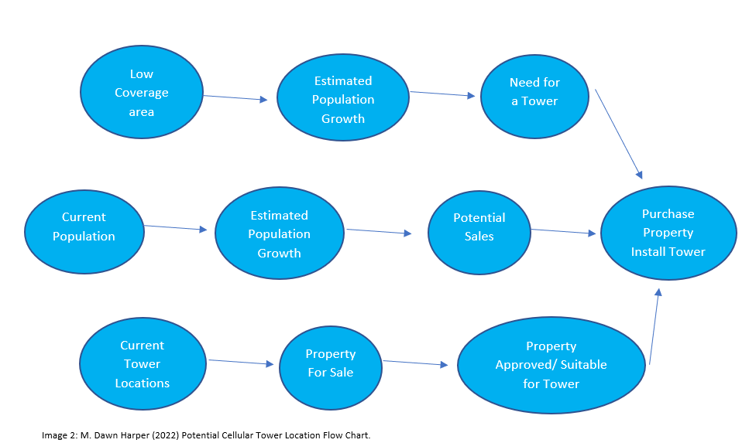
Image 7: M. Dawn Harper (2022) Potential Cellular Tower Location Conceptual Data Model Flow Chart.
Notes:
Project plan approach – Using the Conceptual Data Model, GIS will be used from the very beginning of planning to start with finding rural areas that have the potential for growth, such as within 45 minutes of a military base. Using GIS to find out housing costs, housing availability, and median income will show whether the residents in the area spend on extras such as cellular service. The areas to be considered currently have low to no coverage, and have the space for housing developments for future planning.

Slide 10
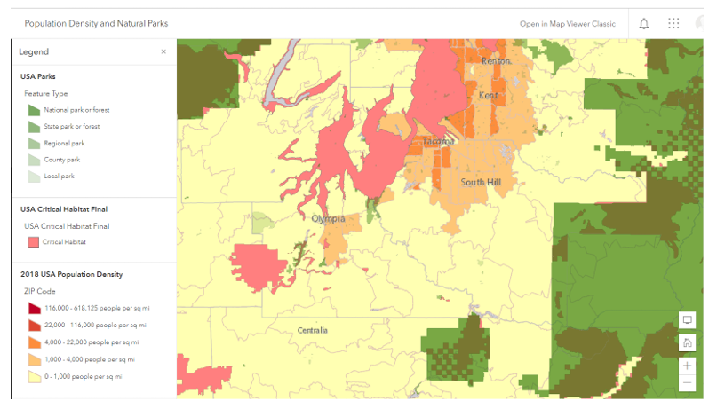
Image 8: ArcGIS (n.d.). Population Density and Natural Parks. ESRI. Retrieved: https://brandman.maps.arcgis.com/apps/mapviewer/index.html?webmap=a8eb85744b9c4fbfa869a32aeb5fc945
Notes:
Ethical Concerns – There are two major ethical concerns T-Mobile needs to be aware of. The locations we are looking at to place a tower may be close to Natural Parks, which may lead to habitat issues as well as a cap on population growth may be enforced. The second ethical concern is that T-Mobile will become the lifeline for locals in the area, they will finally be able to reach emergency services.

Slide 11

Image 9: Phone Ninja (n.d.). So you’re telling me you can fix it? Pinterest. Retrieved: https://www.pinterest.com.au/pin/390476230175981560/?mt=login
Notes:
How sensitive is the assessment to changes in data elements? Thankfully, if some of the key data element is off such as population Growth is not as predicted, T-Mobile will still gain current residents as customers as people in the Clear Lake area and other rural areas are desperate for reliable cellular services.

Slide 12

Image 10: T-Mobile. Emotion Gif. Retrieved: https://gifer.com/en/XlJY
Notes:
Make a decision – “After verifying the housing market data pre and post-covid, geospatial data from the ArcGIS maps, and the demographics for the area including average it is determined as a wise investment for T-Mobile. Using the geospatial data from the ArcGIS maps, and utilizing hot spot technics, it confirms the Clearwood Community is in a no-coverage area solely to a lack of a tower, not due to just being a wooded area. Adding a tower to this location will increase the lives of all the residents as it gives an extra layer of security knowing they can reach emergency personnel when needed” (Harper, 2022).

Slide 13
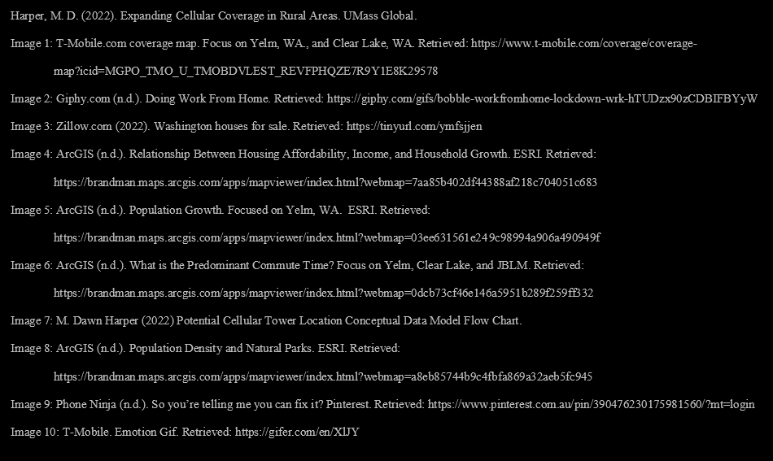
References
Notes:
References

